Slide 1
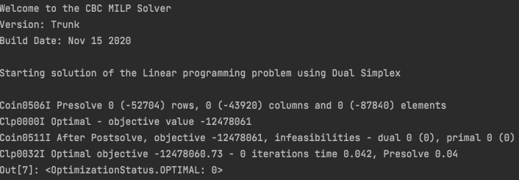
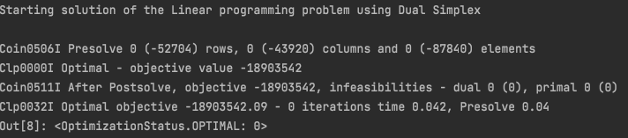
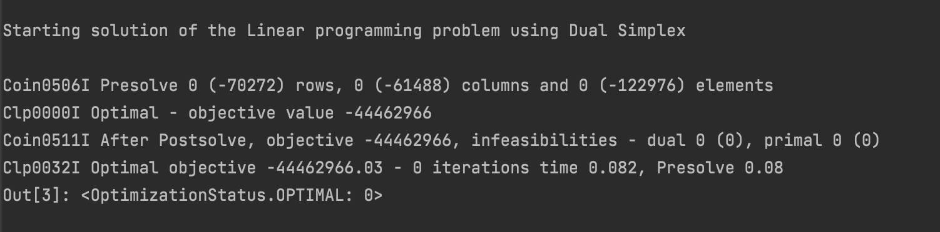
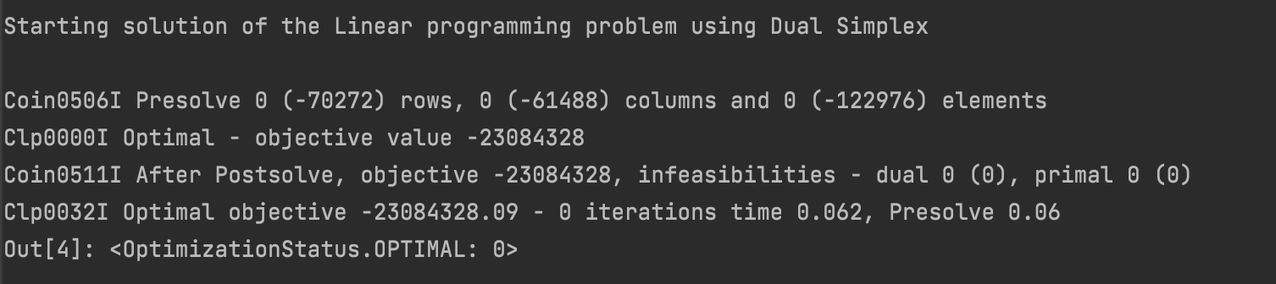
wholesale prices CHP
household prices CHP
wholesale prices CHP + boiler
household prices CHP + boiler

Slide 2
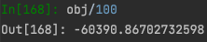
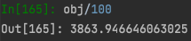
household prices CHP
wholesale prices CHP

Slide 3
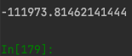
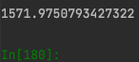
household prices CHP + boiler
wholesale prices CHP + boiler

Slide 4

household prices boiler
heat_cap = (heat_cap*385)/20
wholesale prices boiler

Slide 5


household prices boiler
heat_cap = (heat_cap*385)/20
wholesale prices boiler

